Slide 1
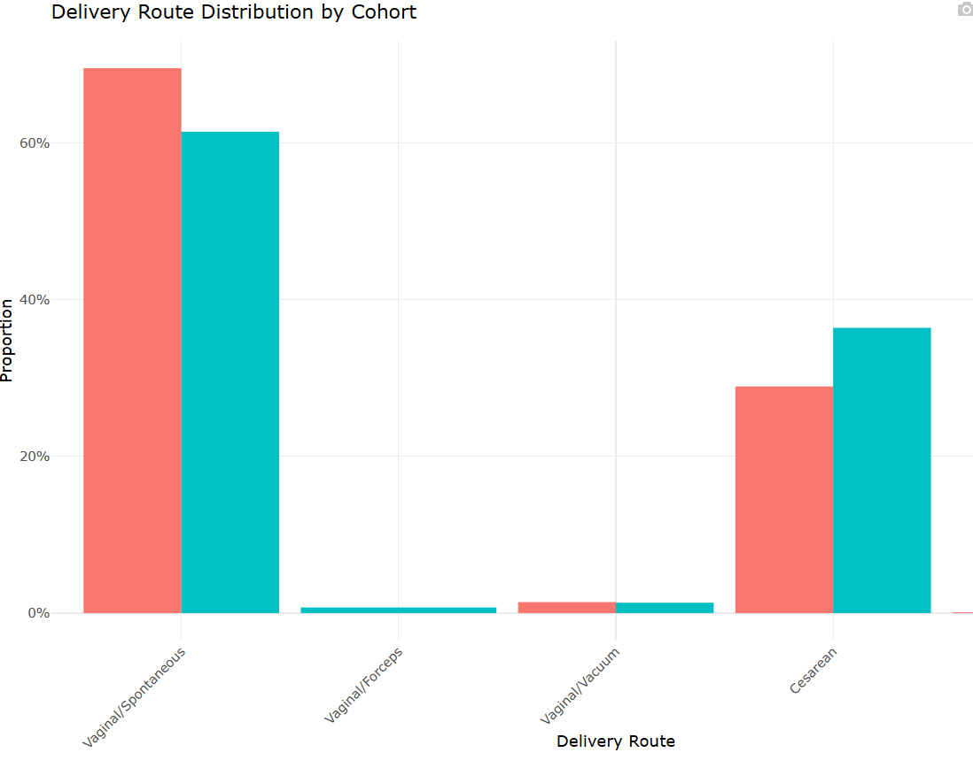

MARCH
Notes:
Birth cer

